Slide 1
Digital Portfolio
STUDENT NAME: SREE KRISHNAN R
REGISTER NO AND NMID: 2428D0058 &
11B38D6B4AA39EB8D824ACDCB42A4CC9
DEPARTMENT: B.Sc Computer Science and Applications
COLLEGE: VET INSTITUTE OF ARTS AND SCIENCE (Co-Education) COLLEGE / BHARATHIAR UNIVERSITY

Slide 2
PROJECT TITLE
Responsive Personal Portfolio Website
Sree Krishnan R Portfolio

Slide 3


AGENDA
Problem Statement
Project Overview
End Users
Tools and Technologies
Portfolio design and Layout
Features and Functionality
Results and Screenshots
Conclusion
Github Link
3/21/2024 Annual Review

Slide 4

PROBLEM STATEMENT
Students and professionals often lack a personal online presence to showcase their skills and projects effectively. A well-designed portfolio website provides an accessible platform to display work, skills, and contact information, making it easier to attract opportunities in academia and industry.

Slide 5

PROJECT OVERVIEW
This project involves designing and developing a responsive personal portfolio website to highlight academic background, technical skills, projects, and contact information. The website offers a smooth browsing experience on various devices and includes interactive navigation and a contact form for user engagement.

Slide 6

WHO ARE THE END USERS?
Potential employers or recruiters evaluating skills and projects.
Academic mentors and peers interested in the student’s work.
Clients or collaborators seeking to assess technical capabilities.
The student as a professional portfolio to support career development.

Slide 7

TOOLS AND TECHNIQUES
HTML5 for webpage structure.
CSS3 for styling and responsive design.
JavaScript for interactivity such as menu toggling and form validation.
Image editing tools for profile picture preparation.
Text editor or IDE (e.g., VS Code) for coding.
Browser developer tools for testing responsiveness and debugging.

Slide 8
POTFOLIO DESIGN AND LAYOUT
Clean and modern UI with a purple-blue gradient background and yellow accent highlights.
Responsive navigation bar with hamburger menu for mobile devices.
Clear section divisions: Home, About Me, Works, and Contact.
Use of cards for project showcases with hover scale effect.
Structured contact form with validation and status feedback.
Optimized for usability on desktop and mobile platforms.
8

Slide 9
FEATURES AND FUNCTIONALITY
Responsive design adapting to screen size.
Smooth scroll navigation with active section highlighting.
Interactive hamburger menu for compact navigation on small screens.
Contact form with input validation and success/error messages.
Project section highlighting key works with descriptions.
Accessible and user-friendly layout emphasizing simplicity and clarity.
GITHUB LINK: https://github.com/Sreekr18/Sree_Krishnan_R-TNSDC-FWD-DP.git

Slide 10
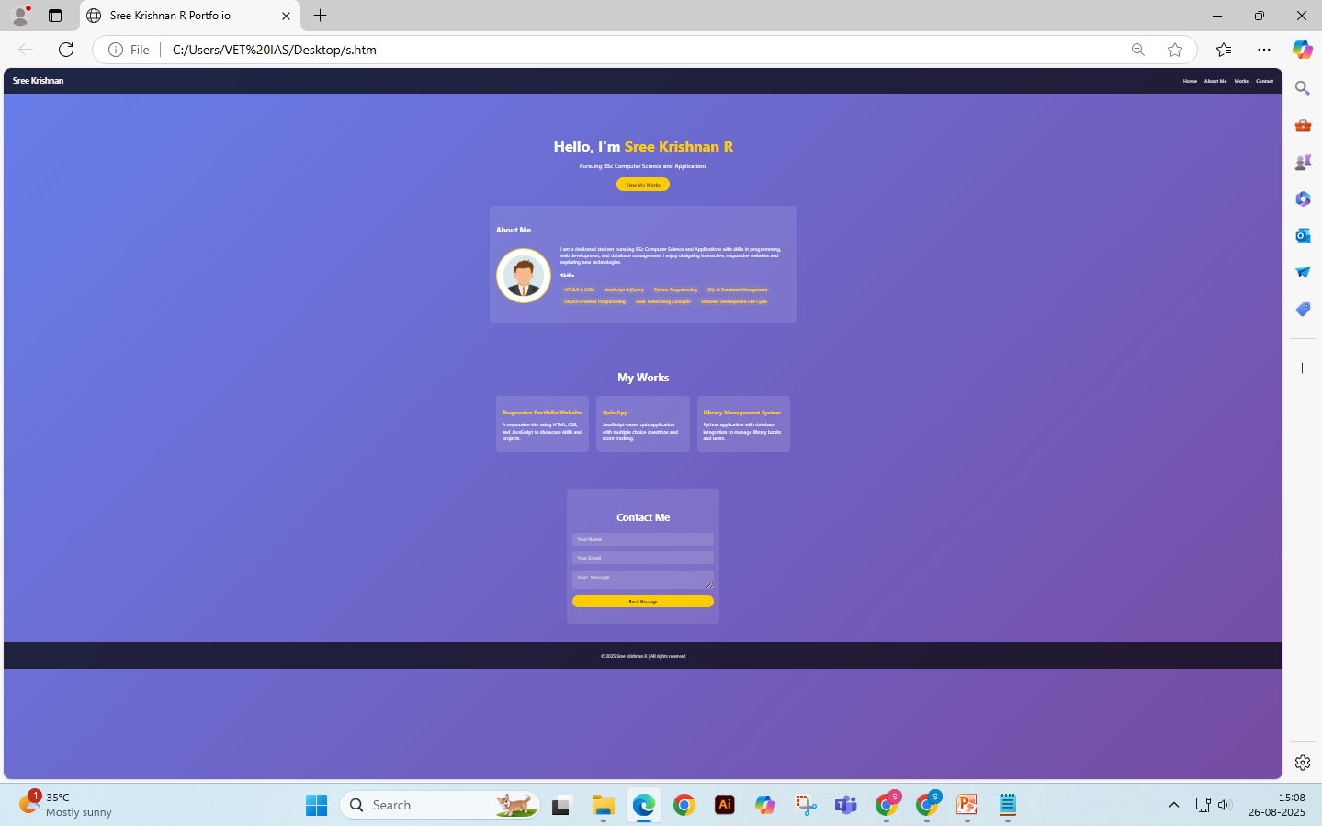

RESULTS AND SCREENSHOTS
Successfully deployed working portfolio website accessible on multiple device types.
Responsive navigation bar toggles smoothly on mobile devices.
Contact form demonstrates validation checks and displays appropriate messages.
3/21/2024 Annual Review
10

Slide 11
CONCLUSION
The portfolio website project provides an effective platform to showcase skills, projects, and contact information in a professional format. It improves online visibility and supports career advancement by offering employers and collaborators easy access to personal and technical information. The responsive design ensures accessibility across multiple devices, enhancing user experience.
11

